Slide 1
BLUESTOCK FINTECH
Mutual Fund Analytics Platform
End-to-End ETL, Performance Analytics & Interactive Dashboard
for 40 Real Mutual Fund Schemes
Individual Capstone Project
Data Analyst Intern | June 2026

Slide 2
THE CHALLENGE
Problem & Objective
India's mutual fund industry has grown to over Rs. 81 lakh crore in AUM, but investors and advisors still lack a unified, data-driven way to compare fund performance.
1
2
3
4
Data Fragmentation
No Risk-Adjusted Comparison
No Benchmark Tracking
Investor Behaviour Blind Spot
NAV, AUM, and SIP data live in different formats across AMFI sources
Raw NAV doesn't reveal Sharpe, Alpha, Beta without heavy computation
Most investors can't tell if their fund beats Nifty 50 / Nifty 100
Limited visibility into demographic & geographic SIP patterns
Objective: Build a full-stack analytics platform — ETL pipeline, SQL database, risk metrics, and interactive dashboard — to close these gaps.
Bluestock Fintech | Mutual Fund Analytics Capstone
02

Slide 3
FOUNDATION
Data Sources & Scope
40
10
46K
32.8K
5,000
4.5 Yrs
Fund Schemes
Fund Houses
NAV Records
Transactions
Investors
NAV History
10 Datasets, All Anchored to Real AMFI India Figures
Fund Master
NAV History
AUM by AMC
SIP Inflows
Category Inflows
Folio Counts
Scheme Performance
Investor Tx
Portfolio Holdings
Benchmarks
Sources: AMFI India (amfiindia.com), mfapi.in REST API, NSE/BSE public data. All figures anchored to genuine AMFI quarterly reports and monthly notes.
Bluestock Fintech | Mutual Fund Analytics Capstone
03

Slide 4
SYSTEM ARCHITECTURE
ETL Pipeline: Extract → Transform → Load → Analyse → Visualise
EXTRACT
TRANSFORM
LOAD
ANALYSE
VISUALISE
10 raw CSVs ingested
& validated
Clean, forward-fill,
validate business rules
SQLite star schema
1 dim + 9 fact tables
CAGR, Sharpe, Alpha,
Beta, VaR, scorecard
16 charts +
4-page dashboard
▶
▶
▶
▶
Database: SQLite star schema — 1 dimension table (dim_fund) + 9 fact tables, indexed on amfi_code and date columns for fast query performance.
Bluestock Fintech | Mutual Fund Analytics Capstone
04

Slide 5
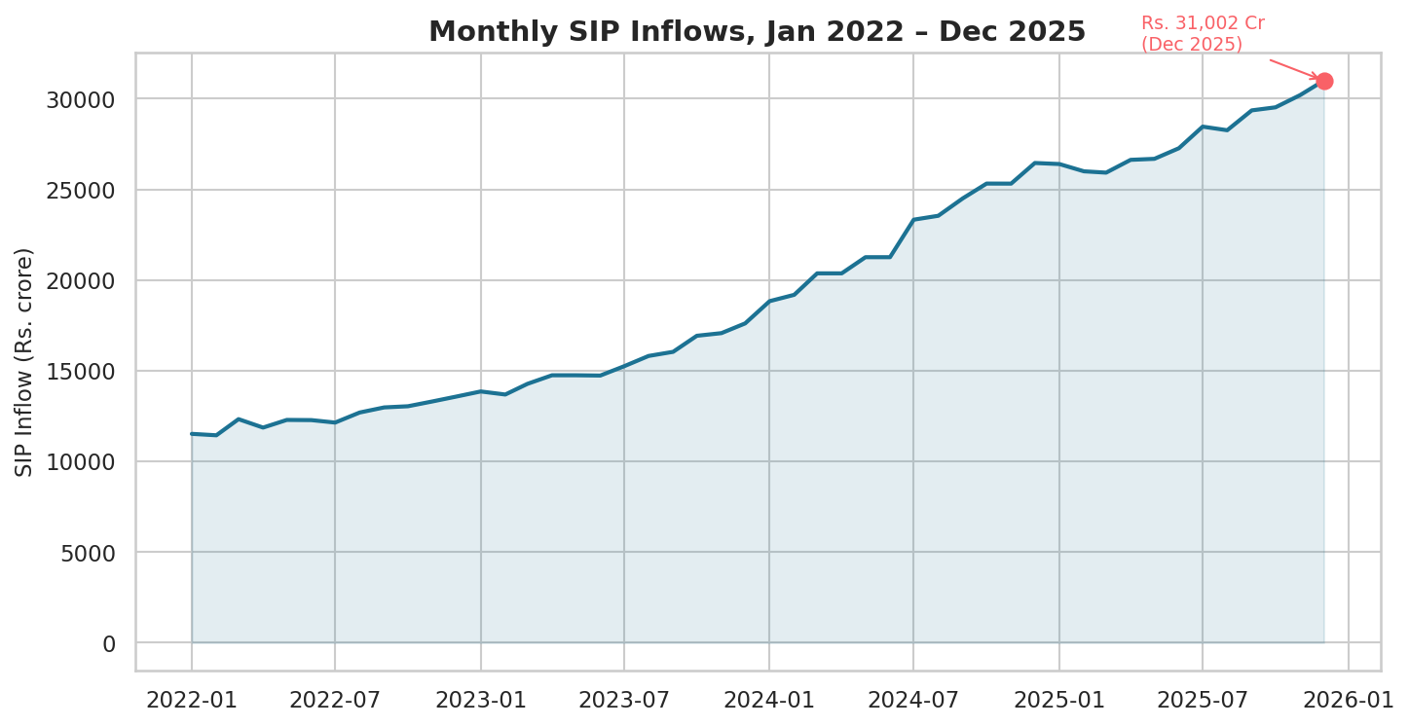
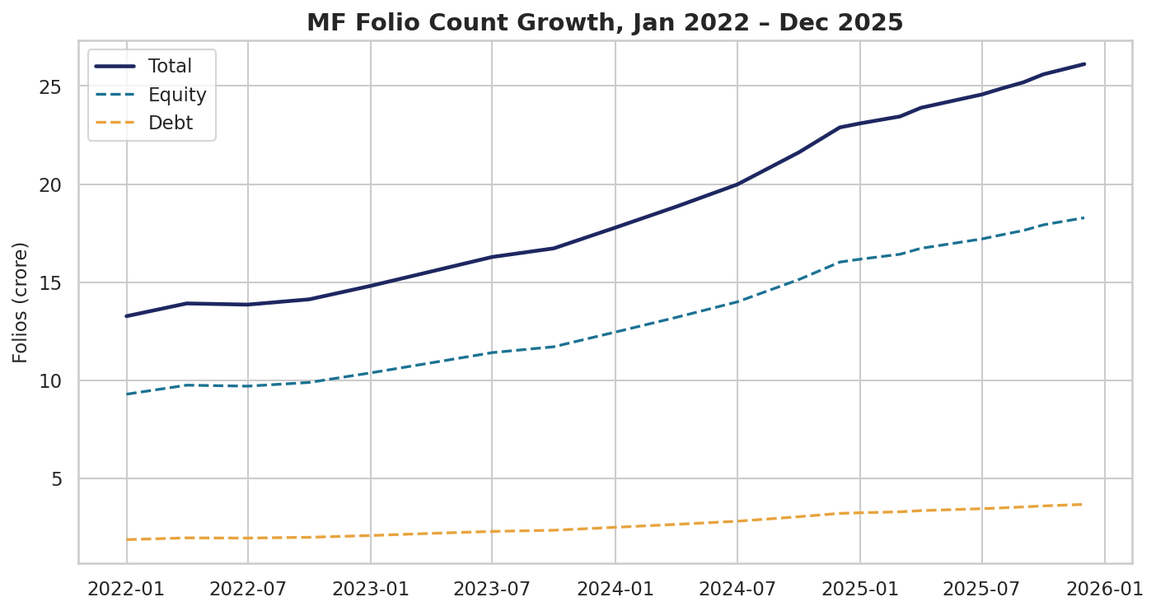
EXPLORATORY DATA ANALYSIS
Industry Growth Trends
SIP inflows hit an all-time high of Rs. 31,002 crore in Dec-2025 (+17% YoY).
Total MF folios nearly doubled, from 13.26 Cr to 26.12 Cr, over the dataset window.
Bluestock Fintech | Mutual Fund Analytics Capstone
05

Slide 6
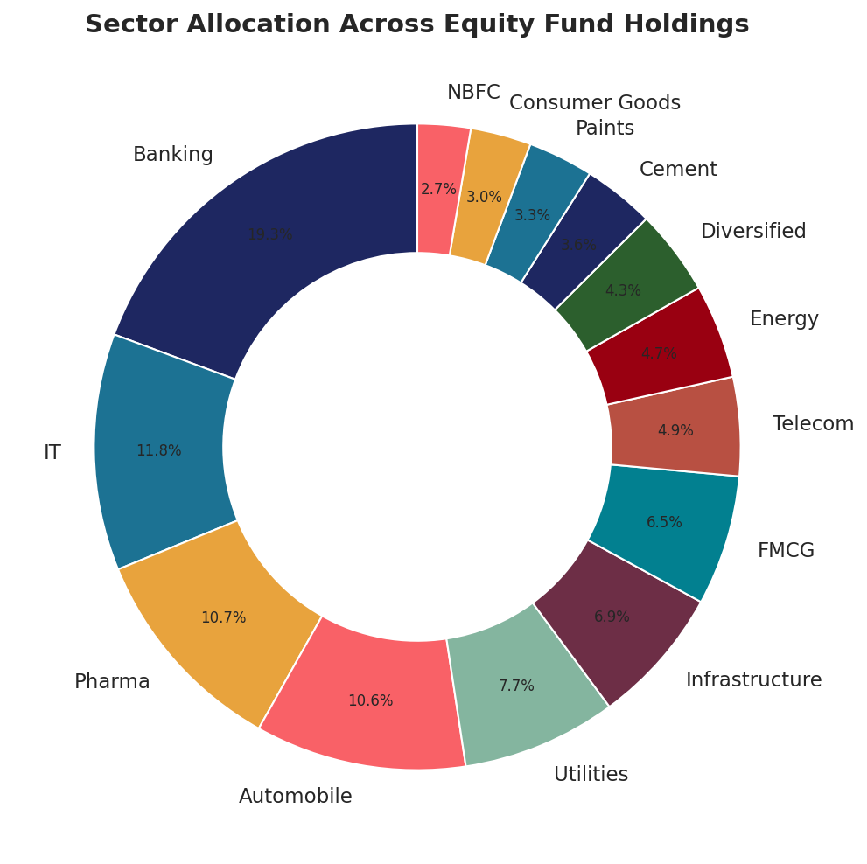
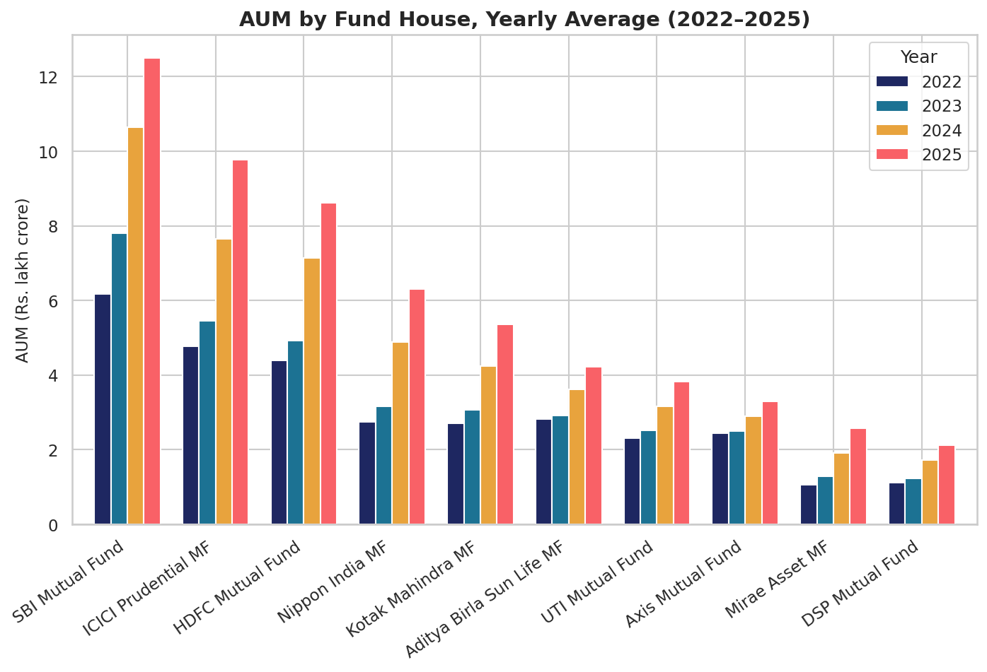
EXPLORATORY DATA ANALYSIS
AUM Leadership & Sector Mix
SBI Mutual Fund leads AUM at Rs. 12.5 lakh crore, ahead of ICICI Prudential and HDFC.
Banking and IT are the two largest sector exposures across equity fund holdings.
Bluestock Fintech | Mutual Fund Analytics Capstone
06

Slide 7
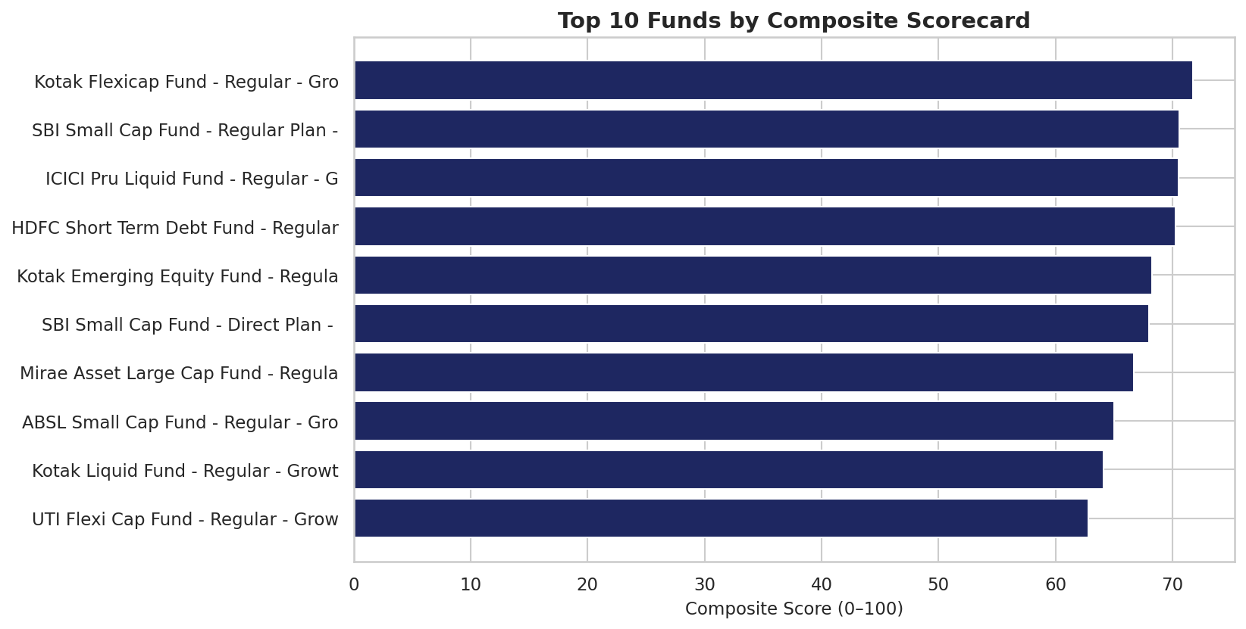
PERFORMANCE ANALYTICS
Composite Fund Scorecard
Score = 30% × 3yr Return + 25% × Sharpe + 20% × Alpha
+ 15% × Expense Ratio (inv.) + 10% × Max Drawdown (inv.)
#1 RANKED FUND
Kotak Flexicap Fund
(Regular - Growth)
Score: 71.8 / 100 | 3yr Return: 15.7%
Bluestock Fintech | Mutual Fund Analytics Capstone
07

Slide 8
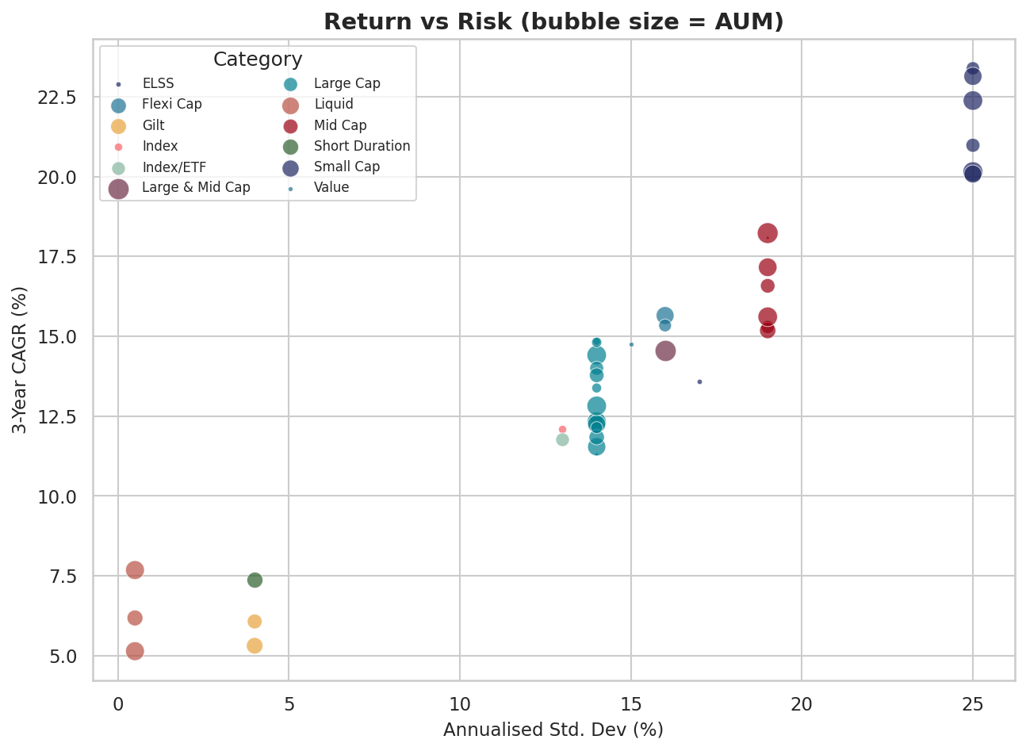
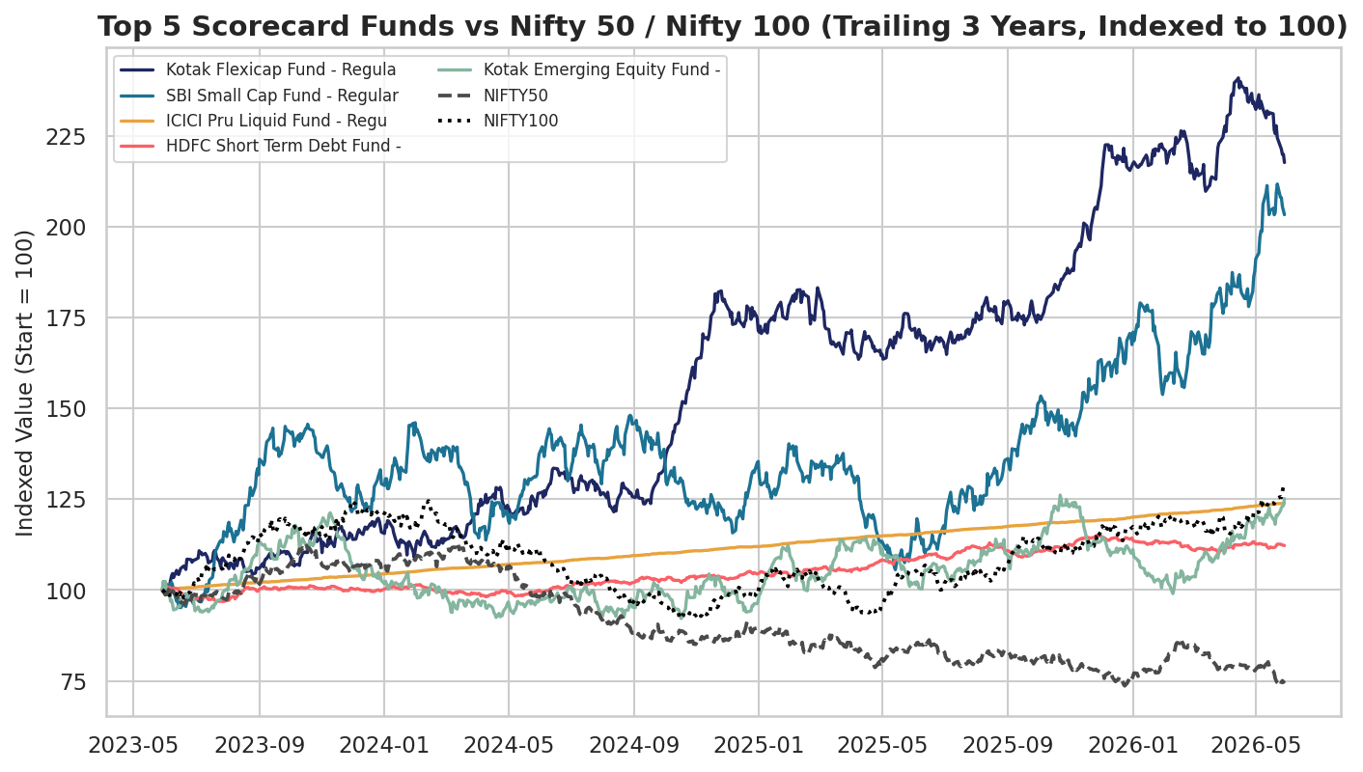
PERFORMANCE ANALYTICS
Return vs Risk & Benchmark Comparison
Bluestock Fintech | Mutual Fund Analytics Capstone
08

Slide 9
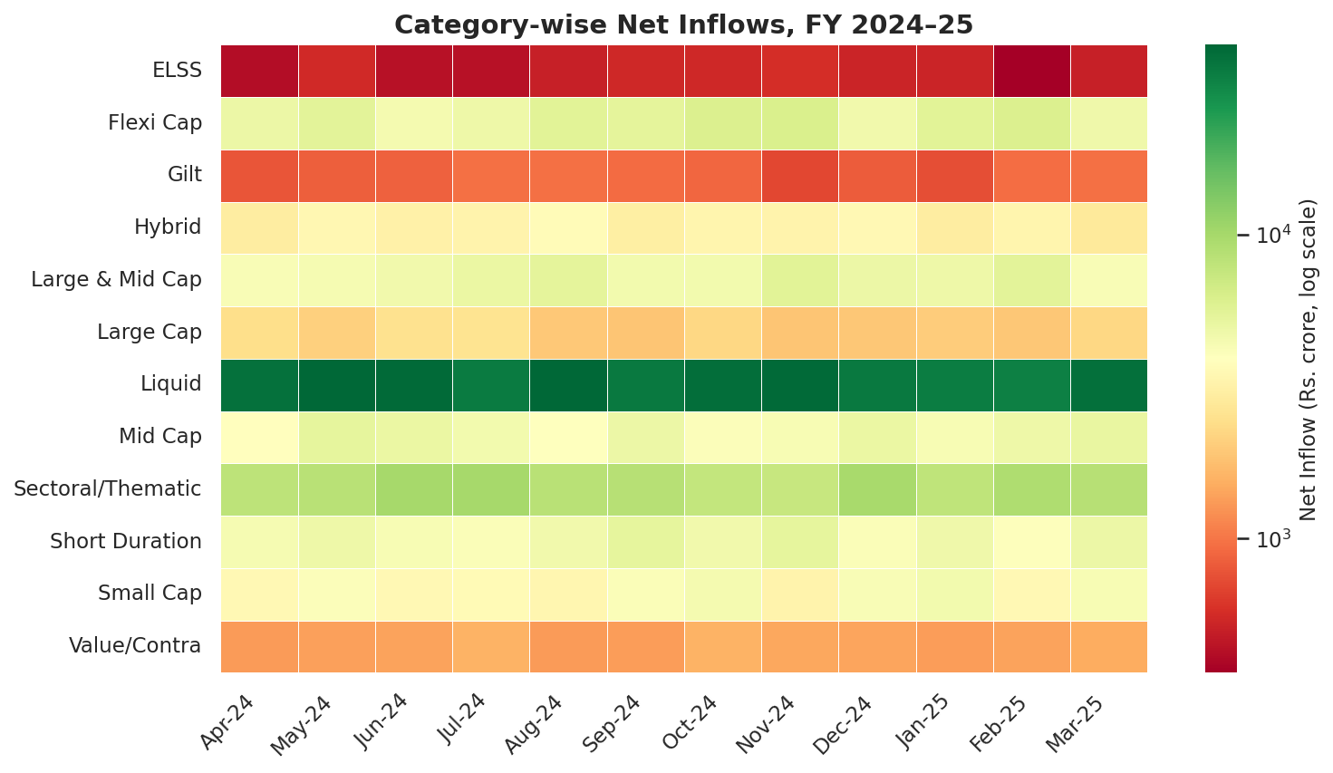
INTERACTIVE DASHBOARD
4-Page Power BI / Tableau Design
1. Industry Overview
2. Fund Performance
3. Investor Analytics
4. SIP & Market Trends
KPI cards · AUM trend · AMC bar chart
Return-risk scatter · scorecard · NAV vs benchmark
Geo map · SIP split · demographics
Dual-axis SIP+Nifty · category heatmap
Every page includes 2+ interactive slicers (Fund House, Category, State, Age Group, City Tier)
Bluestock Fintech | Mutual Fund Analytics Capstone
09

Slide 10
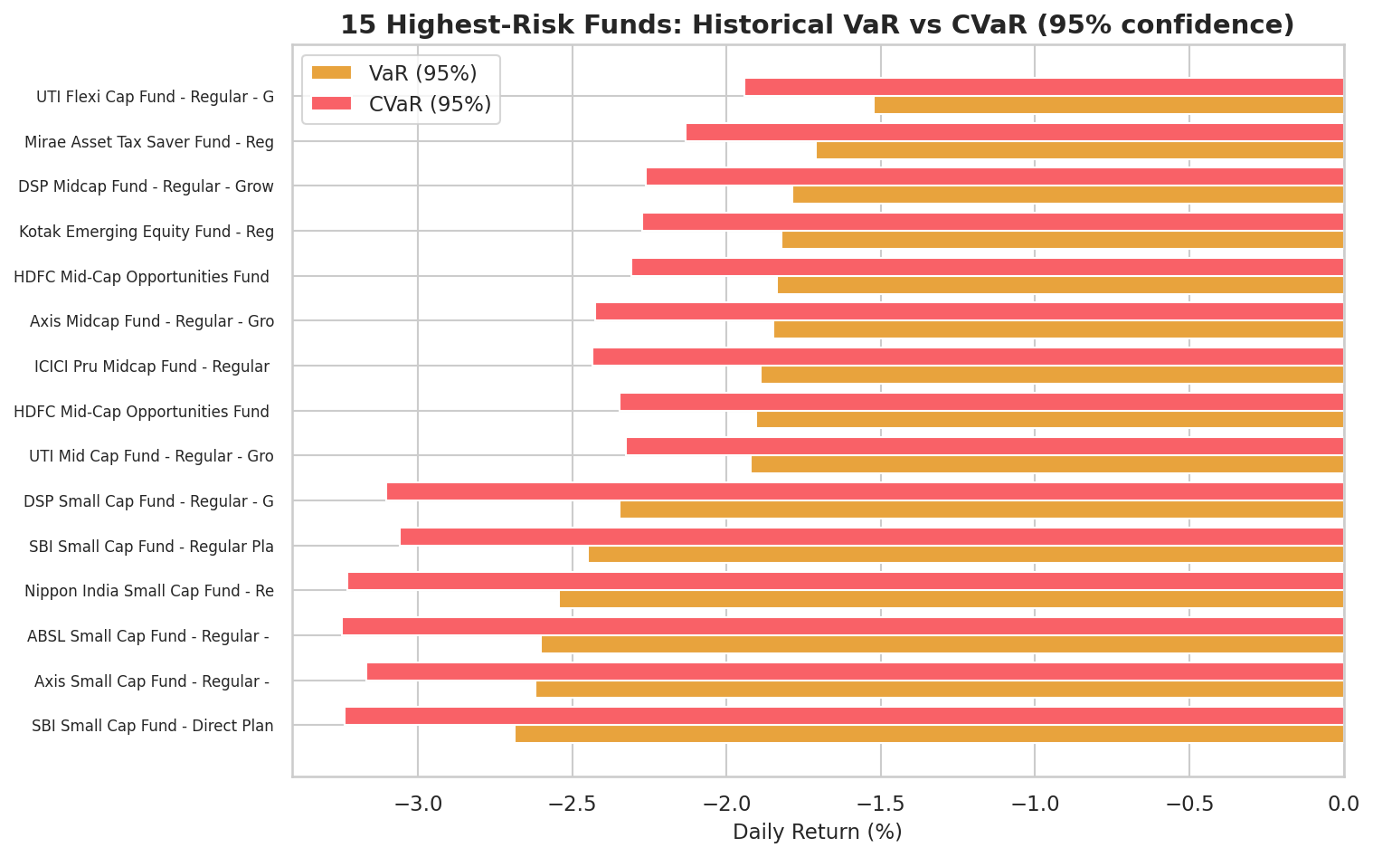
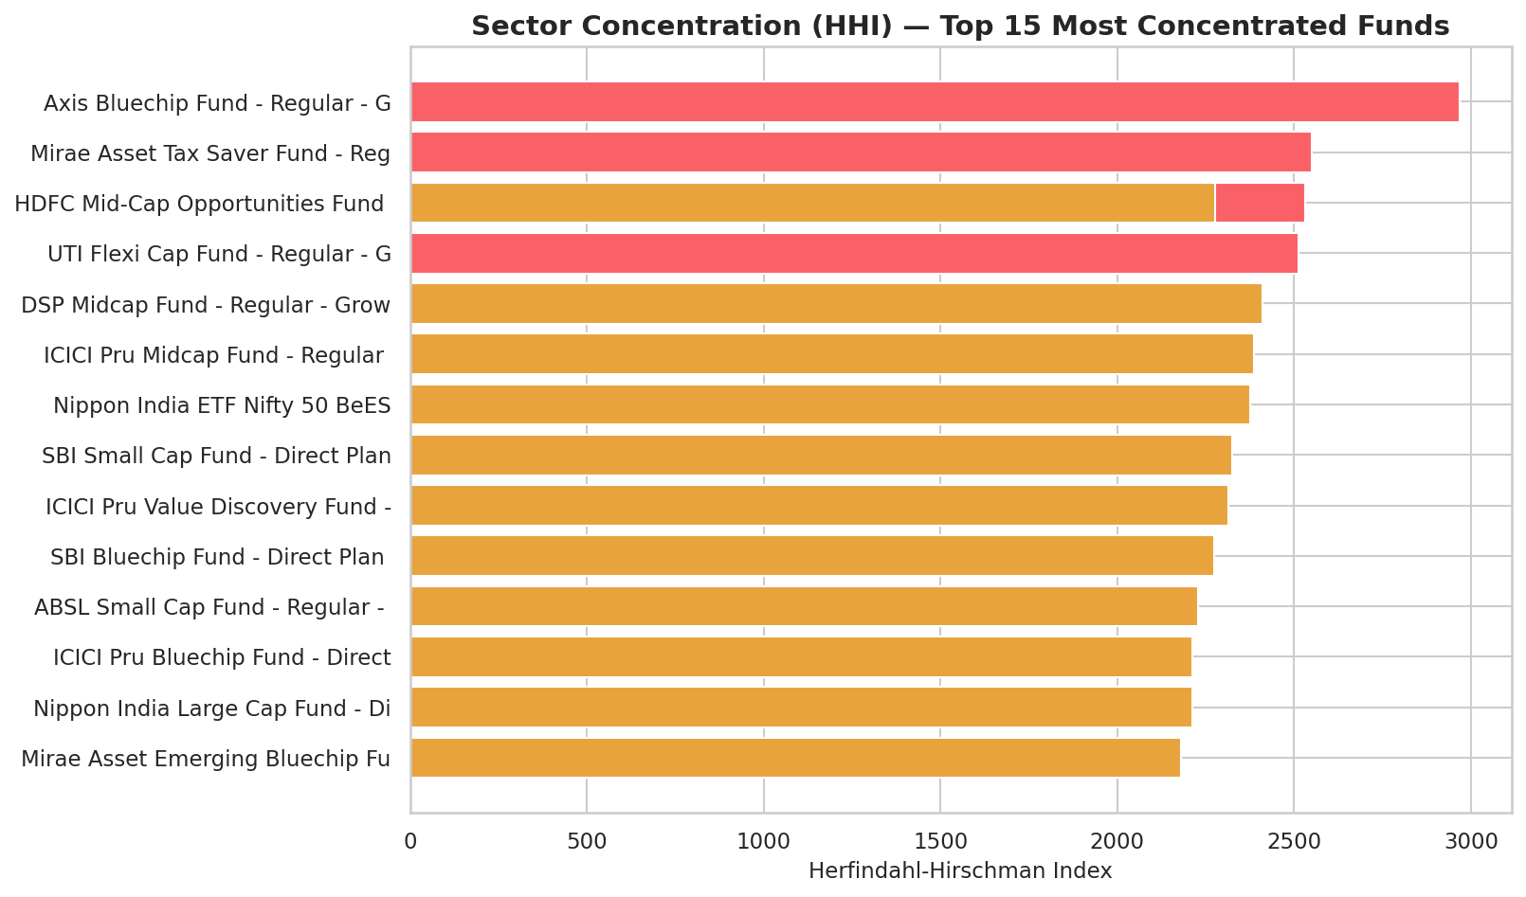
ADVANCED ANALYTICS
Risk Metrics & Investor Behaviour
Bluestock Fintech | Mutual Fund Analytics Capstone
10

Slide 11
SYNTHESIS
Key Findings & Recommendations
WHAT WE FOUND
RECOMMENDATIONS
SIP inflows hit an all-time high of Rs. 31,002 crore in Dec-2025 (+17% YoY)
Promote the composite scorecard, not raw returns, as the primary comparison tool
SBI Mutual Fund leads AUM at Rs. 12.5L Cr; Kotak Flexicap tops the composite scorecard
Small-cap funds carry the highest VaR/CVaR and realised volatility of any category
Use sector HHI alongside volatility when assessing equity fund risk
T30 cities drive ~66% of transaction value; B30 contributes a meaningful ~34%
Validate behavioural findings against real (not simulated) transaction data
Several funds carry sector concentration risk (HHI > 2,500) not visible in headline volatility
Continue tracking B30 contribution — already meaningful, likely growing
Bluestock Fintech | Mutual Fund Analytics Capstone
11

Slide 12
Thank You
Bluestock Fintech | Mutual Fund Analytics Capstone
Full code, notebooks, SQL, and report: github.com/anshuldeepbajpai-dhoni/Bluestock-mutual-fund-analytics
12

